Slide 1
Liquid level control system using PID
Group Members
R. Deepak Sethupathy MSM17B004
S. Sriram MSM17B016

Slide 2
Abstract
The purpose of this project is to demonstrate an innovative approach for low cost continuous liquid level monitoring based on PID control system. Most of the traditional measuring systems were designed and implemented by complicated hardware circuitry. It made the product expensive, with low functionality and with limited precision. With digital measurement technology, more of the instrument can be substituted by software, and sensors. Using this approach the cheaper and more versatile measurement system can be developed. A prototype of a liquid level monitoring system based on ultrasonic sensors, water pump, and Arduino IDE is developed for measuring liquid level accurately and accordingly maintaining the level of liquid close to the reference level. Set level can be changed to introduce flexibility. LCD display is integrated to allow real time monitoring.

Slide 3
Introduction
Many industrial and scientific processes require knowledge of the quantity of content of tanks and other containers. In many instances it is not possible or not practical to directly view the interior. The more obvious industrial applications include: tank level gauging of milk, beer or wine in food and beverage industry; level gauging of acid, oil and solvent vessels in chemical plants; level monitoring of water in reservoirs. Over the last several decades, computer control of manufacturing systems has been the focus of extensive research. Advances in microprocessor, computing, networking and interfacing technologies have improved capabilities of industrial measurement and monitoring systems substantially over the period. The availability of water resources on earth are limited and unevenly distributed. The conservation of our water resources depends on our wise use of these resources. The development of virtual and open architecture monitoring systems shifts the focus of automation from being hardware centric to software centric, providing further flexibility. Therefore an experimental setup will be constructed to control liquid level in a tank using arduino IDE. In this project we are using ultrasonic sensor to measure liquid level.

Slide 4
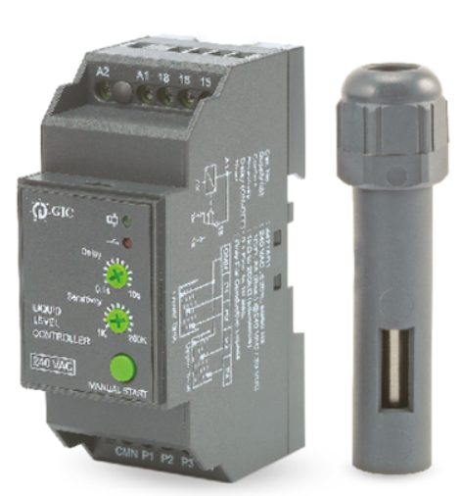
Literature Survey
The aesthetically made Level Controller by GIC India is perfect to protect submersible pumps from dry running and at the same time, prevents overfilling. It has a fully automatic operation functionality, helping it to drain and fill simultaneously. Fully Automatic operation enabling both draining and filling simultaneously with a single device.
Zhao Dandan ; Zou Zhiyun ; Yu Meng ; Huang Yue ; Guan Chen has studied about liquid level control system [2]

Slide 5
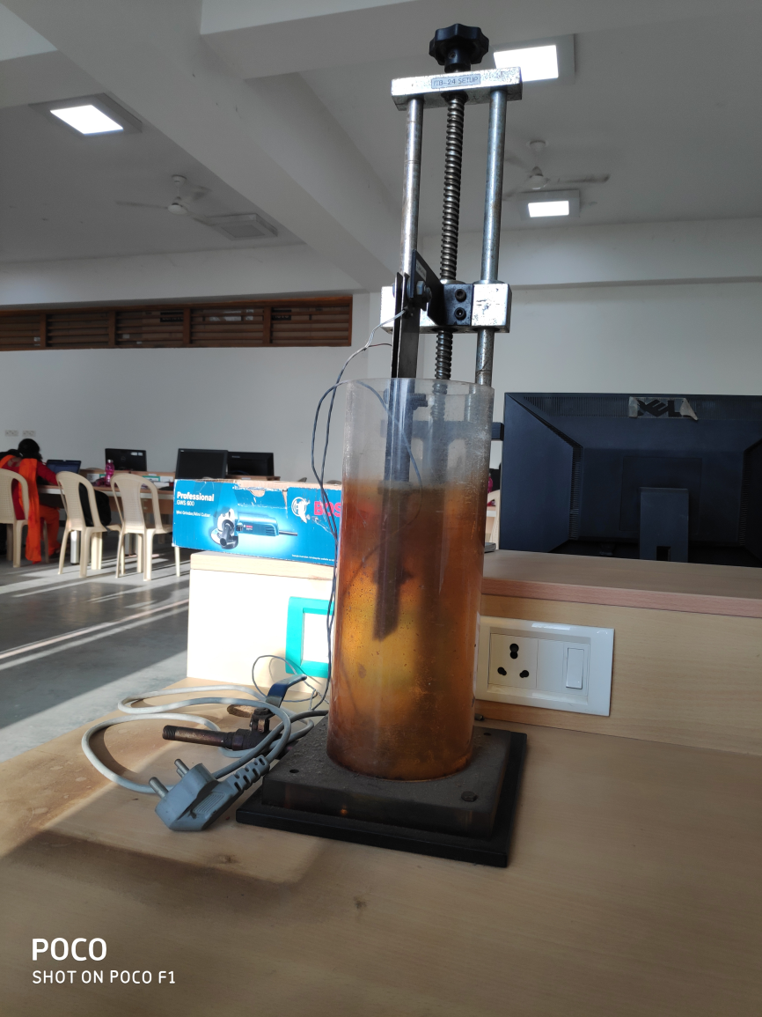
Liquid level control system in L214

Slide 6
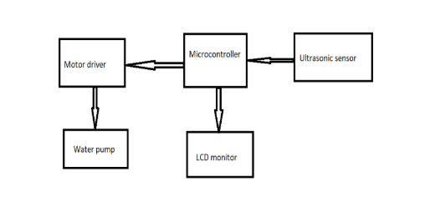
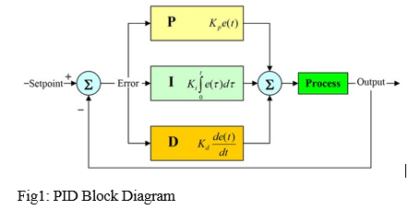
Control system block diagram

Slide 7
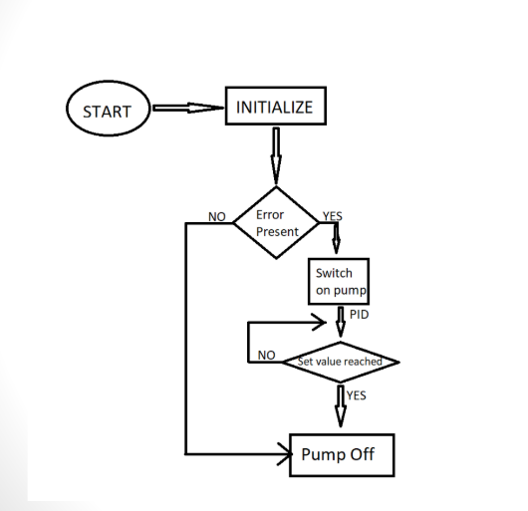
Flowchart

Slide 8
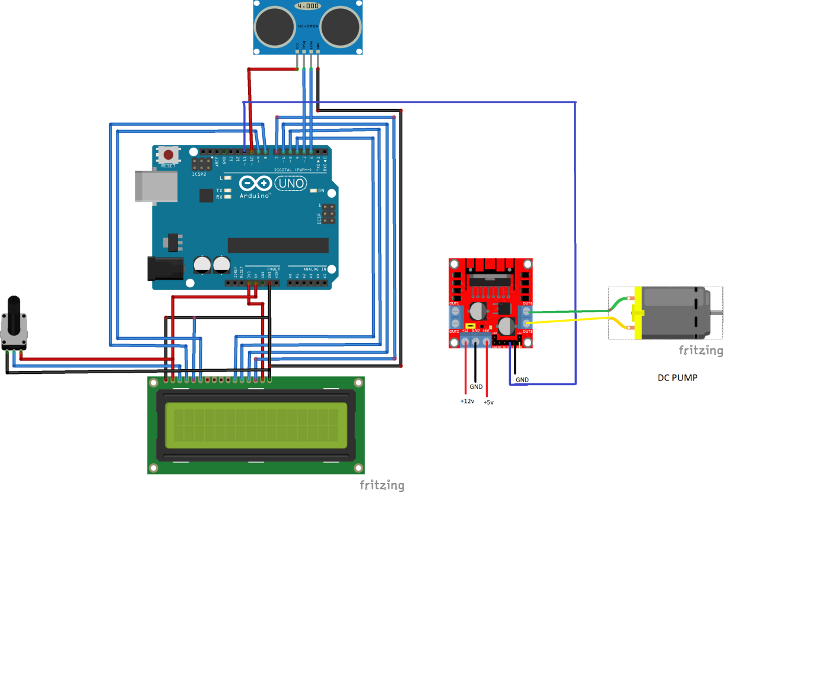
Circuit diagram for liquid level control system

Slide 9
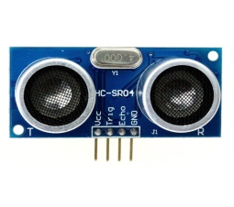
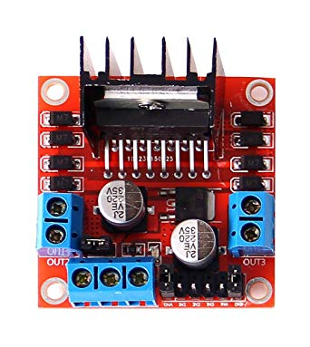
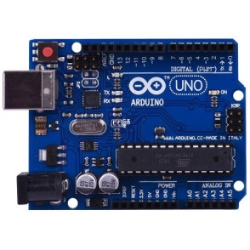
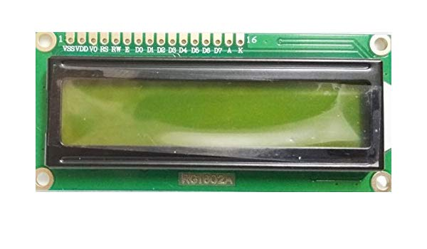
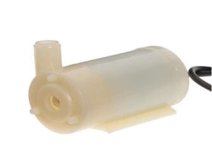
Components used
HC-SR04 Ultrasonic sensor
Ultrasonic ranging module HC - SR04 provides 2cm - 400cm non-contact
measurement function, the ranging accuracy can reach to 3mm. The modules
includes ultrasonic transmitters, receiver and control circuit
L298 Motor driver
Arduino. This allows you to control the speed and direction of two DC motors, or
control one bipolar stepper motor with ease. The L298N H-bridge module can be used with
motors that have a voltage of between 5 and 35V DC.
Arduino UNO
The Arduino Uno is a microcontroller board based on the ATmega328 (datasheet). It has 14 digital
input/output pins (of which 6 can be used as PWM outputs), 6 analog inputs, a 16 MHz ceramic
resonator, a USB connection, a power jack, an ICSP header, and a reset button
RG1602A LCD Display
LED Lighting Color SBM-160 Red, Green, Blue, White - Cool (RGBW) 623nm Red, 530nm Green, 458nm Blue, 7100K White 8-SMD Module
3-6V DC Submersible water pump
DC 3-6V Mini Micro Submersible Water Pump for fountain, garden and controlled water
hydroponic systems

Slide 10
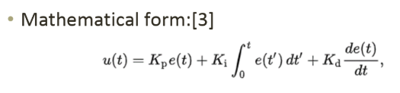
PID Control
PID control algorithms is a classical algorithm of the earliest development and application, the PID controller has the advantage of simple structure, control easily, good robustness and high accuracy.
Term P is proportional to the current value of the SP − PV error e(t). If error is large output is propotionally large.
Term I accounts for past values of the SP − PV error and integrates them over time to produce the I term.
Term D is a best estimate of the future trend of the SP − PV error, based on its current rate of change. It is sometimes called "anticipatory control“. The more rapid the change, the greater the controlling or dampening effect.

Slide 11
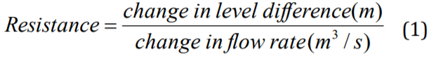





Mathematical modelling [3]
CAPACITANCE OF LIQUID-LEVEL SYSTEMS =
Rate of change of fluid volume in tank = flow in – flow out

Slide 12

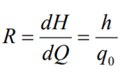





Cross sectional area can be replaced by capacitance
Resistance R may be written as
Substitute h/R
Transfer function can be obtained

Slide 13
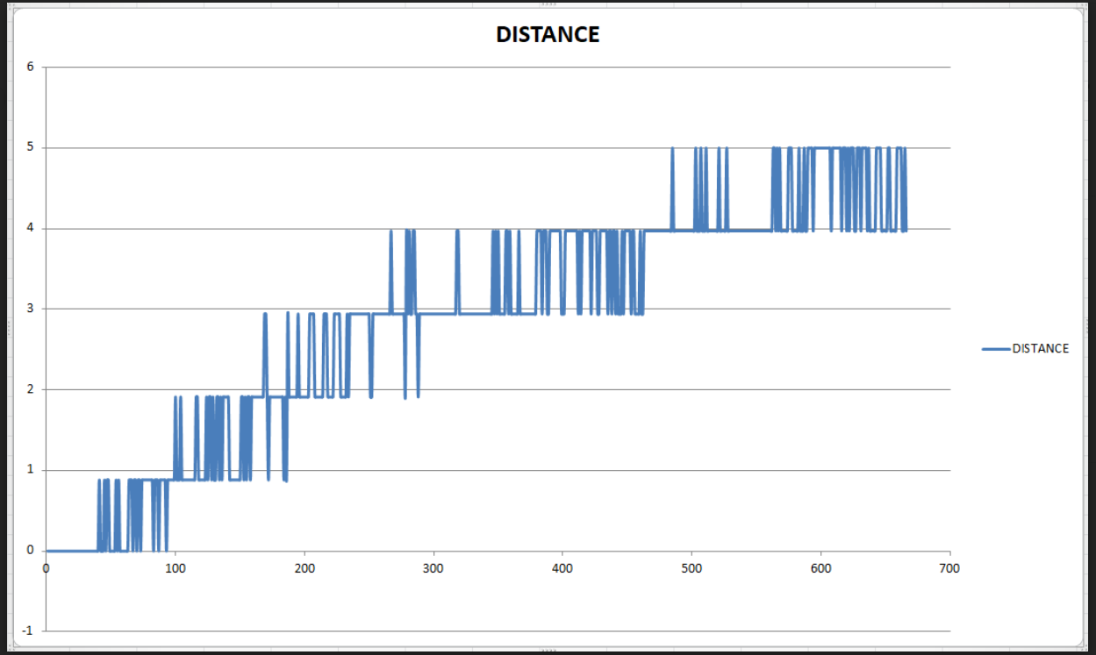
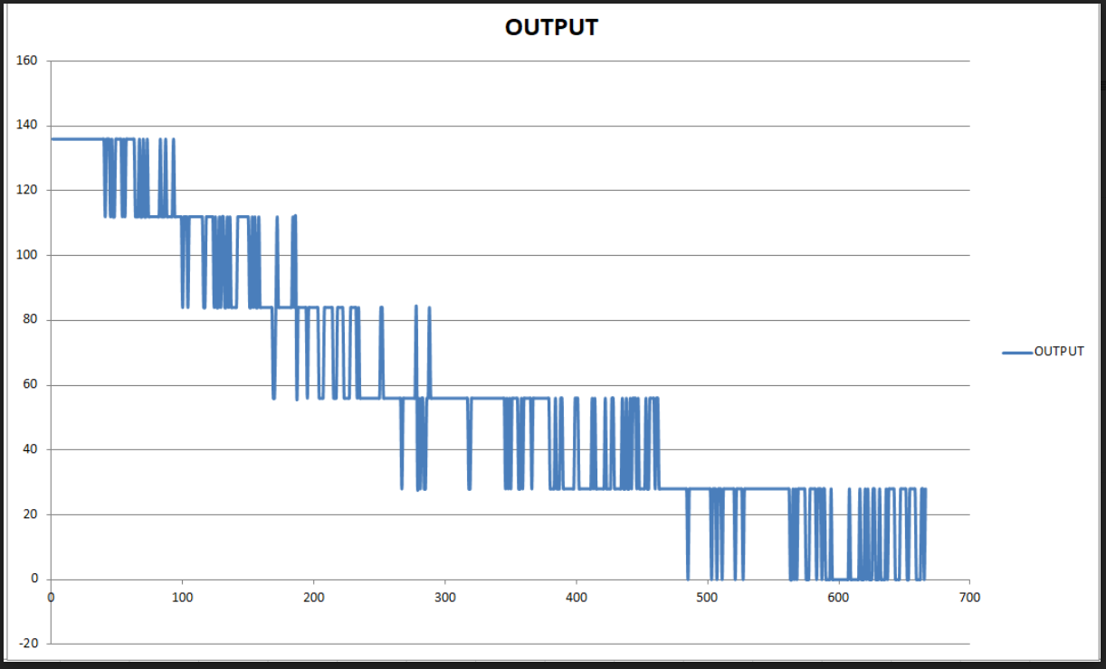
PID Graphs
Distance vs time graph
Kp=4 Kd=7 Ki=6
Output vs time graph
We can observe in Distance vs time graph that as time increases the water level increases towards 5. Here the set point is 5. According to PID control the output voltage should decrease with decrease in error. This can be clearly inferred from above graph.

Slide 14
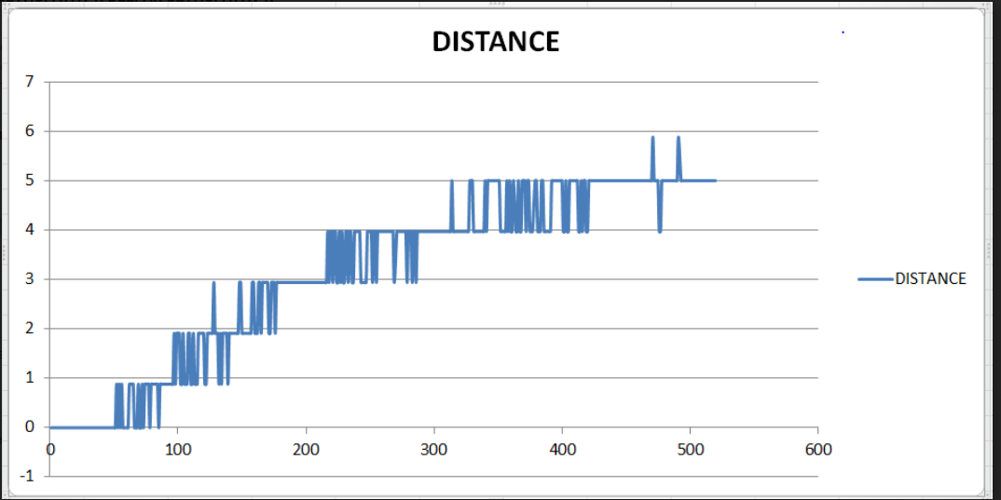
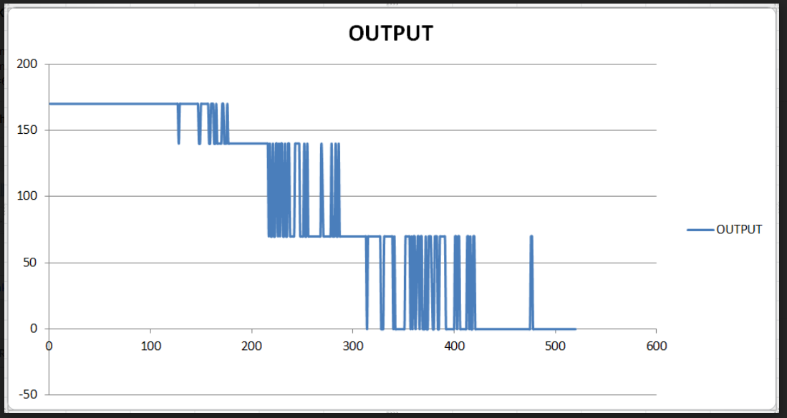
Distance vs time graph
Output voltage vs time graph
For the above graph Kp value was increased to 10. It can be observed that set value is reached much faster than previous case. There is also few overshoots due to increased Kp.

Slide 15
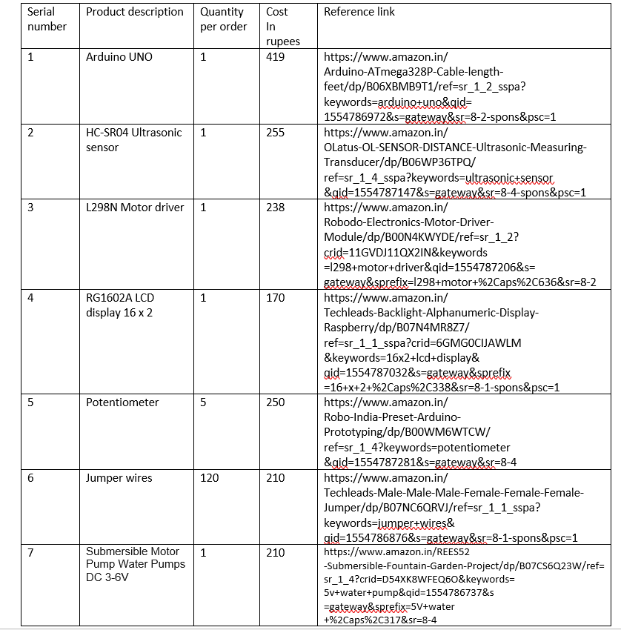
Bill of materials
Total cost | 1752

Slide 16
References
[1] GIC India[online]. Available: https://www.gicindia.com/monitoring-devices/level-monitoring/
[2] Liquid level PID control system[online] Available: https://ieeexplore.ieee.org/document/7053438
[3] F. Ma, "An improved fuzzy PID control algorithm applied in liquid mixing system," 2014 IEEE International Conference on Information and Automation (ICIA), Hailar, 2014, pp. 587-591. doi: 10.1109/ICInfA.2014.6932722
[4]Deign Gloria Jose and Shalu George K, “Modelling and Controller of Liquid Level system using PID controller”

